Slide 1
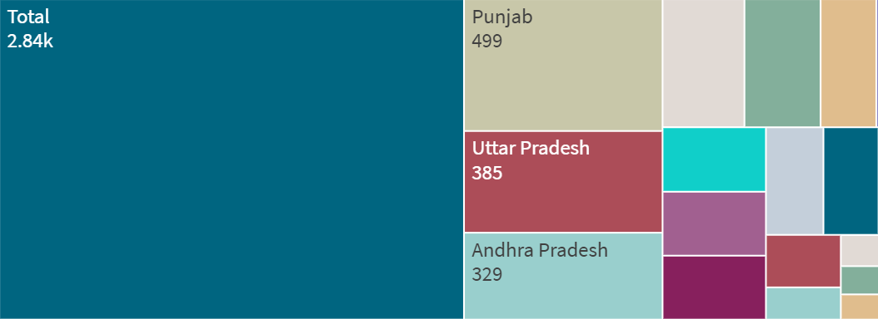


Accidents near Traffic Signals
TOTAL ACCIDENTS AT TRAFFIC SIGNALS
HIGHEST.’ PUNJAB @,
PERSONS KILLED
PERSONS INJURED

Slide 2




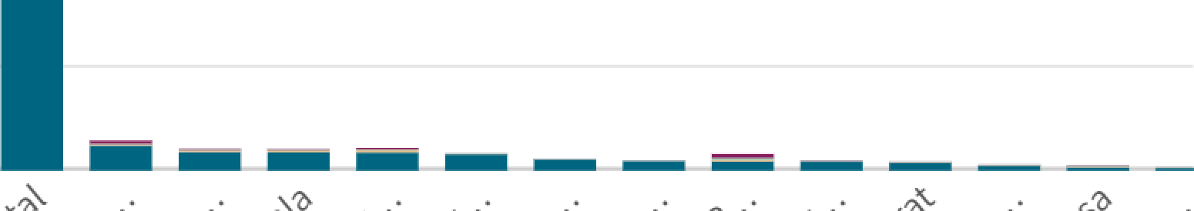








Speed and Weather
Correlation - Speeding and Number of accidents
400k
Total
[Over-Speed
200k
G...
0
Maximum Number of Accidents occur During Sunny Weather
o
1ook 200k 300k 400k Avg([Total - Number of Road Accidents])
Sook
Accidents by Weather Type
600k
Positive Correlation between Speeding and
Number Of Accidents
400k
200k
0
pO

Slide 3























































Road Users Killed
120k
Measures
100k
Cars,faxis,\fans
80k —
Auto Rickshaws
Other Hon Notorized Vehicles
60k —
Two Wheelers
40k
M Bicycles
20k
e
b
b
qb
b*’
States UTs
Road User Category with Highest number of deaths: Two Wheelers

Slide 4
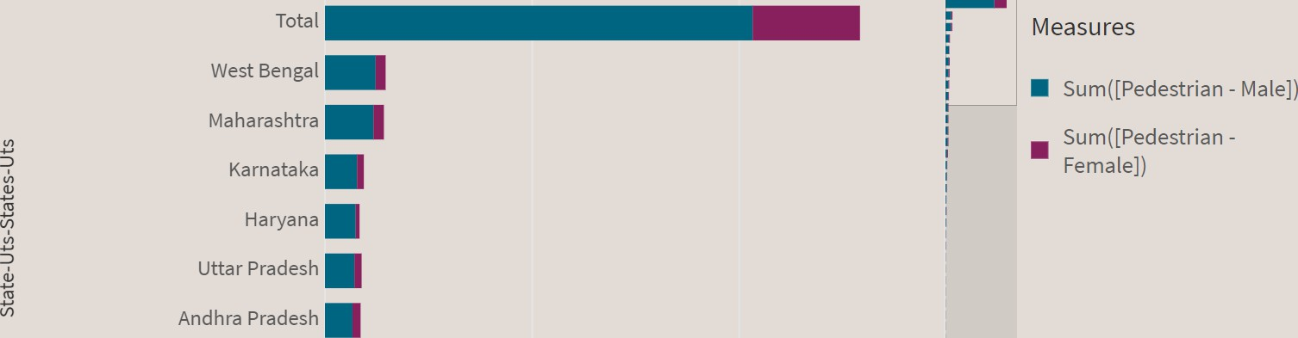
Pedestrians Killed : Gender
Highest Number Of Pedestrians Killed : Male
Madhya Pradesh
Rajasthan
0
10k
20k
30k
Sum([Pedestrian - Male]), St
Pedestrian - Female])

Slide 5











Pedestrian Killed : Age
Age Groups Killed
Measures
, 2. .,
— 18-25
— Age Not Known Senior Citizens
4k
Sen
2k
State-Uts-States-Uts
Age Group With Highest Number nf Pedestrians Killed : 45-60

Slide 6
Police Controlled Areas
STATE WISE DISTRIBUTION OF ACCIDENTS \•
The oota set contains negative or zero values that cannot 6e shown in this cloud.
NUMBER OF PERSONS KILLED
TOTAL NUMBER OF ACCIDENTS
^y'
NUMBER OF PERSONS GRIEVIOUSLY INJURED
Number of Persons Grieviously Injured
10.6Sk

Slide 7
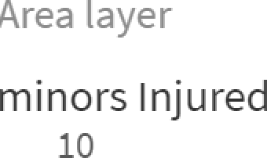
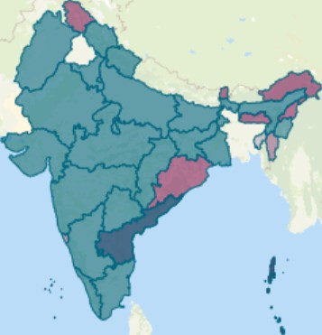
Highest Number Of Minors Injured : AndhraPradesh
Minors Injured across the country
State-Uts-States- Uts
OpenStreetMag contributors
0

Slide 8


States UTs
Total
4.01k
•
Tamil Nadu
1.05k
Andaman and Nicobar Island
Andaman and Nicobar Islands
Punjab
746
States UTs
Uttar Pradesh
680
Haryana
3 7
Andhra Pradesh
Delhi
320
Andhra pradesh
Cause : Jumping Red Signal
Assam 128
Arunachal Pradesh
Madhya Pradesh₁
Jharkhand 107
118
0
2k
4k
6k
Jumping Red Signal
Highest : Punjab
1 0I I

Slide 9
States/UT
Causes of Accidents
Total
Uttar Pradesh
U Assam Haryana Jharkhand
Punja a
Orissa
Madhya Pradesh Orissa
Punjab Tamil Nadu Total
Uttar Pradesh Others
Cause :
Drunken Driving
States/UT
Tamil Nadu
Madhya Pradesh
Jharkhand
Highest : Uttar Pradesh
Haryana
Assam
Others
0
6,500
13,000
Drunken Driving
1 0I I

Slide 10





Accidents by Vehicle Type
Vehicle Type that is Involved in most Accidents : Two Wheeler
Total
Measures
Tamil Nadu
I
Sum([Two Wheelers - Number of Road .
Sum([Two Wheelers - Number of Persons - ...
Sum([Two Wheelers - Number of Persons - ...
Sum([Two Wheelers - Number of Persons - ...
Stat-e Ut-s State-s Uts
Madhya Pradesh
I
Kerala
Karnataka
Maharashtra
I
Uttar Pradesh
II
o 1ook
Sum([Two ... , Sum([T
200k
300k 400k
... , Sum([Two Wh...

